Slide 1



Slide 2
Domain Background
The pre-owned car or used car market crossed the 4 million units mark in FY 2018, which states that the used car market is 1.3 times of the new car market. One of the key growth drivers of the market is the revision of the GST rate on used cars from 28% to 12-18%.
The Indian used car market was valued at USD 24.24 billion in 2019, and it is expected to register a CAGR of 15.12% during the forecast period (2020-2025).
Stepping into 2020, the economic downturn caused by the pandemic further reduced the buying power of consumers towards a new car.

Slide 3


Problem Statement
Consumers manually bring their cars down to workshops just to estimate the selling price of their used cars. This process takes up a lot of time and resources, in addition, human negligence may cause inaccuracy in the price prediction process.
Our Aims & Objective
Analyze and identify the factors that potentially influence the used cars price.
Build a prediction model which can automatically help new car-sellers better and efficiently suggesting suitable price to list their used cars at.

Slide 4
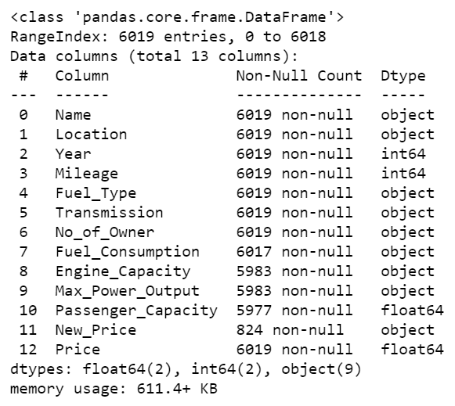
Data Exploration - Data dictionary & size
Data size
Total of 6019 rows and 13 columns
Target (y)
Price : The price of the used car in INR Lakhs
Features (X)
Name : The brand and model of the car
Location : The location in which the car is being sold or is available for purchase
Year : The year or edition of the model
Seats : The number of seats in the car
Fuel_Type : The type of fuel used by the car
Transmission : The type of transmission used by the car
Owner_Type : Whether the ownership is Firsthand, Second hand or other
Mileage : The standard mileage offered by the car company in kmpl or km/kg
Engine : The displacement volume of the engine in cc
Power : The maximum power of the engine in bhp
Kilometers_Driven : The total kilometers driven in the car by the previous owner(s) in KM
New_Price : Price of new model

Slide 5

Data Cleaning

Slide 6
Data Cleaning
A) Re-structure the data
1) Rename column's name to be more locally contact :
2) Convert feature’s object dtype to numerical dtype :
1) No_of_Owner 3) Max_Power_Output
2) Fuel_Consumption 4) Engine_Capacity
3) Split and remove the string object in the cell :
1) Engine_Capacity 3) Max_Power_Output
2) Fuel_Consumption
Name : < No change >
Location : < No change >
Year : < No change >
Kilometers_Driven : changed to "Mileage“
Fuel_Type : < No change >
Transmission : < No change >
Owner_Type : changed to "No_of_Owner"
Mileage : changed to "Fuel_Consumption“
Engine : changed to "Engine_Capacity“
Power : changed to "Max_Power_Output“
Seats : changed to "Passenger_Capacity“
New_Price : < No change >
Price : < No change >

Slide 7

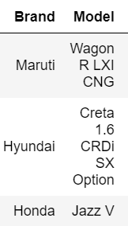
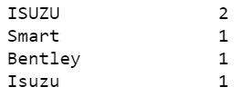

Data Cleaning
A) Re-structure the data
4) Split the Brand and Model name :
5) Combine duplicated Brand name :

Slide 8


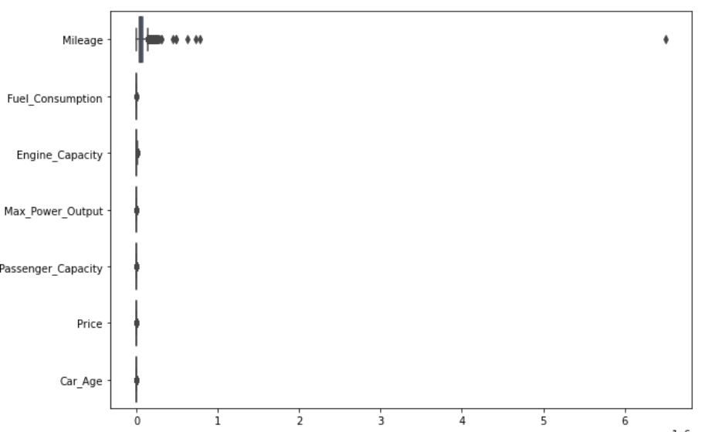
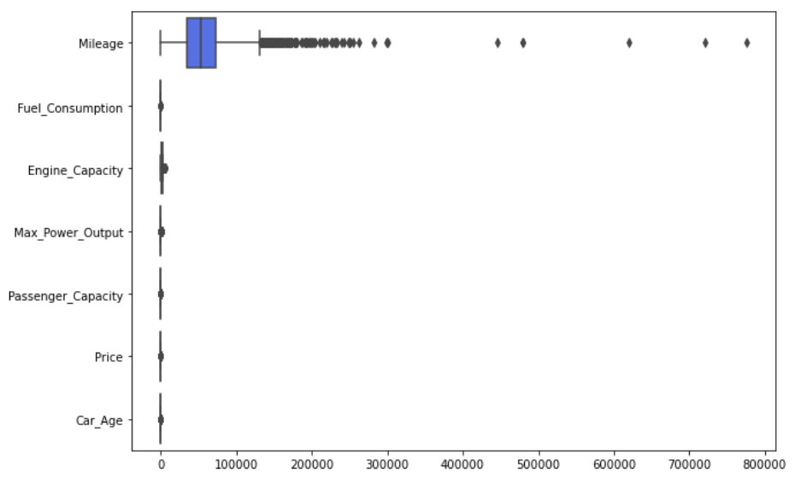
Data Cleaning
A) Re-structure the data
6) Convert Year to Car_Age :
B) Filter unwanted outliers and utilize useful data
1) Remove the error data :

Slide 9
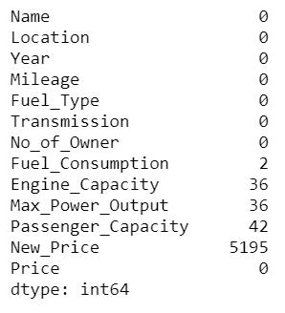
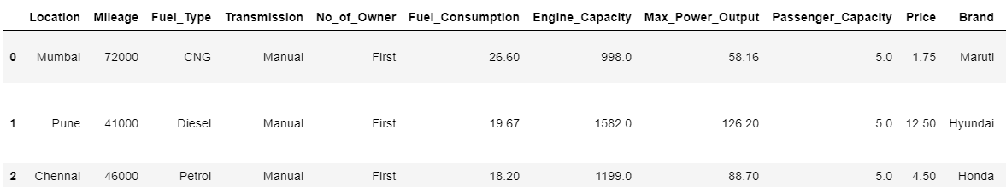
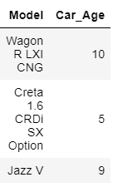
Data Cleaning
Handling missing value - Nan & 0
i) Replace with mean value since the data distribution is quite balance
ii) Replace with median value since the data distribution is imbalance
iii) Drop the column since 86% of the data is nan value
Fuel_Consumption
Engine_Capacity
Max_Power_Output
Passenger_Capacity
New_Price

Slide 10

Data Preprocessing

Slide 11
Data Pre-processing
Encoding the categorical data
i) By One Hot Encoder due to variable do not likely to have any ranking with them
ii) By Ordinal Encoder due to variable likely to have ranking with them
iii) By Frequency Encoder due to variable likely to have some level of popularity with them
Log transformation to transform skewed data to approximately conform to normality
Fuel_Consumption
Transmission
Location
No_Of_Owner
No_Of_Owner
Brand
Model
Mileage
Engine_Capacity
Max_Power_Output
Price
Car_Age

Slide 12
Data Pre-processing
Split the data into train and test set
Standardize features by removing the mean and scaling to unit variance
70% Train / 30% test
StandardScaler

Slide 13

Visualization / EDA

Slide 14
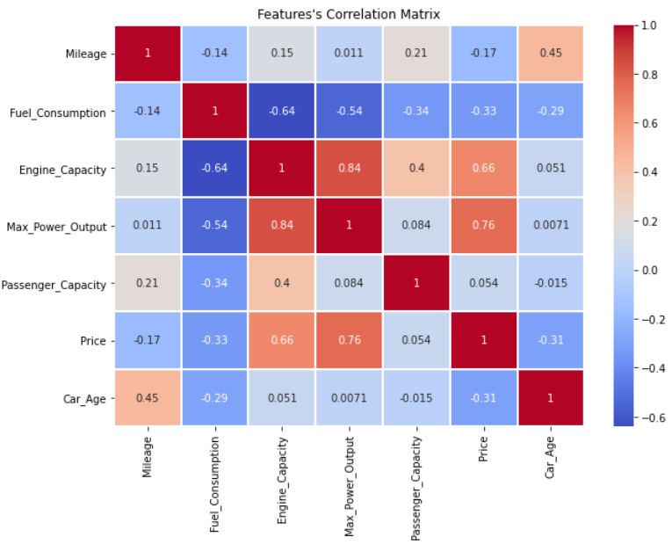
👉 Heat map of feature correlation only compared the numerical features.
Positive correlation:
If an increase in feature A leads to an increase in feature b, then they are positively related. A value of 1 indicates a complete positive correlation.
Negative correlation:
If the increase of feature A leads to the decrease of feature b, then there is a negative correlation. A value of -1 indicates a complete negative correlation.
Highlights :
If Engine_Capacity or Max_Power_Output increase, used car price will also be increased.
On the contrary, if Fuel_Consumption or Car_Age increased, used car price will go down instead.

Slide 15
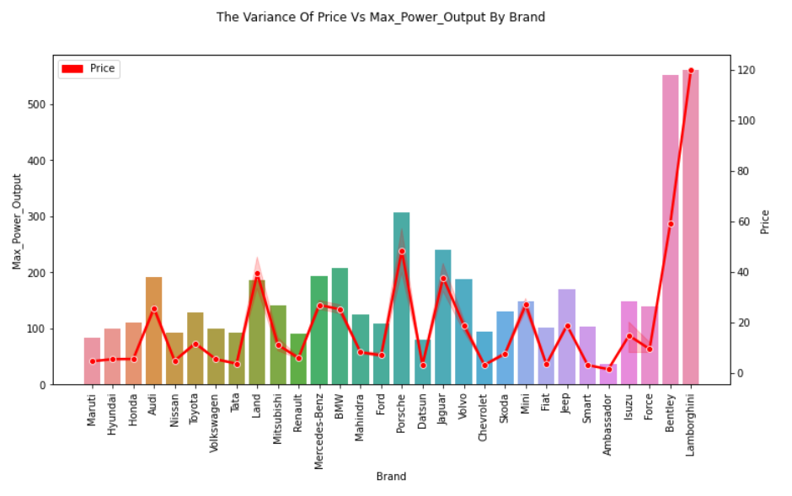
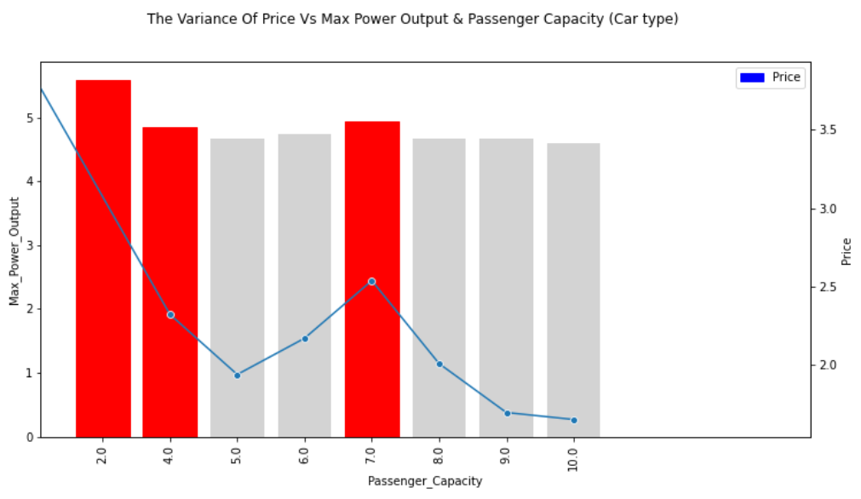
Max Power Output
Used car price tie very closely with the Max_Power_Output.
In general, high-horsepower cars belong to luxury car categories, therefore price expected to be higher. To generate higher profit thru higher selling price, 2, 4 and 7 seated cars should be the focus categories.

Slide 16
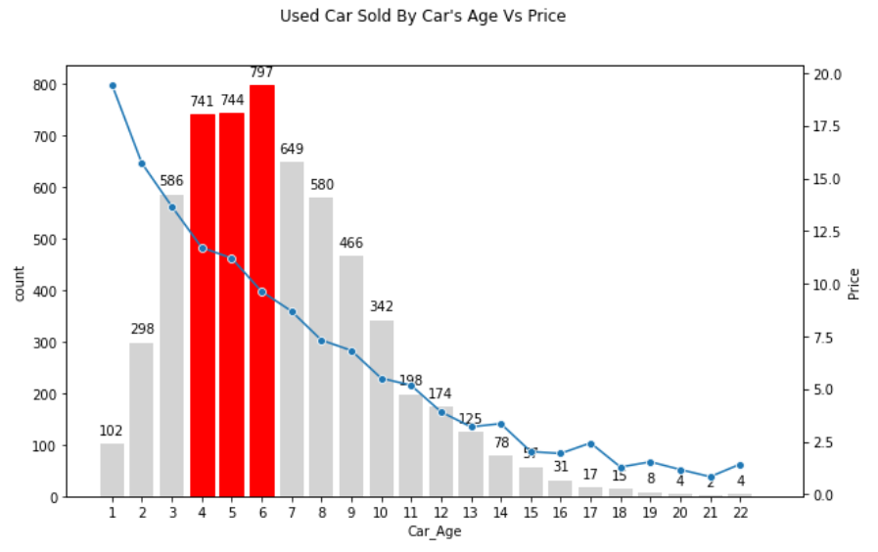
High depreciation
Low depreciation
Car Age
Due to the high depreciation from 1st year to 3rd year, used car aged from 4 to 6 years is more popular. The above illustration shows that from the 4th years onwards, the depreciation value started to cut down tremendously.

Slide 17
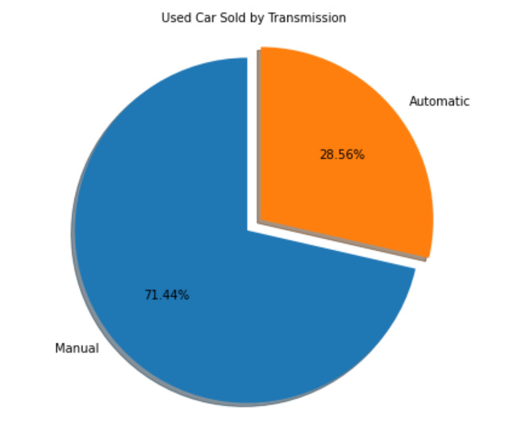
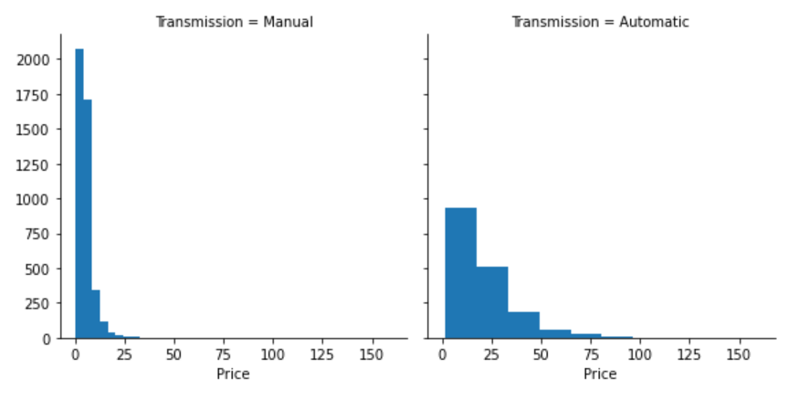
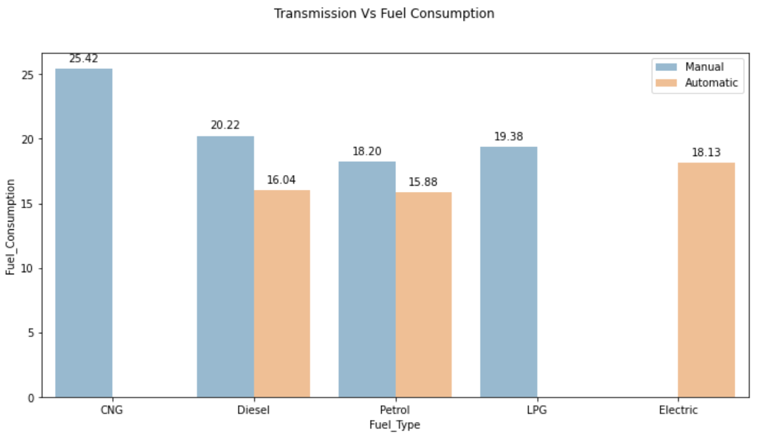
Transmission
A manual car is more popular in the Indian market. Besides the overall price is cheaper, the fuel consumption of a manual car is more savings compared to an automatic car.

Slide 18
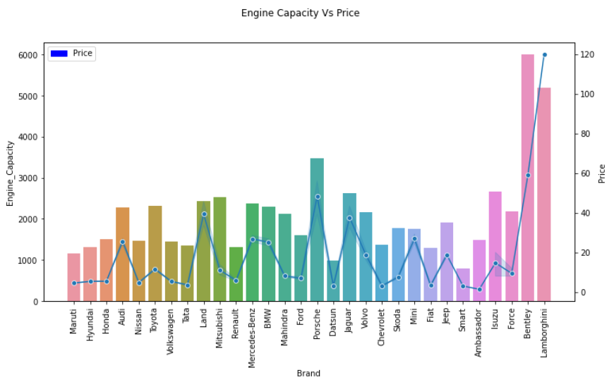
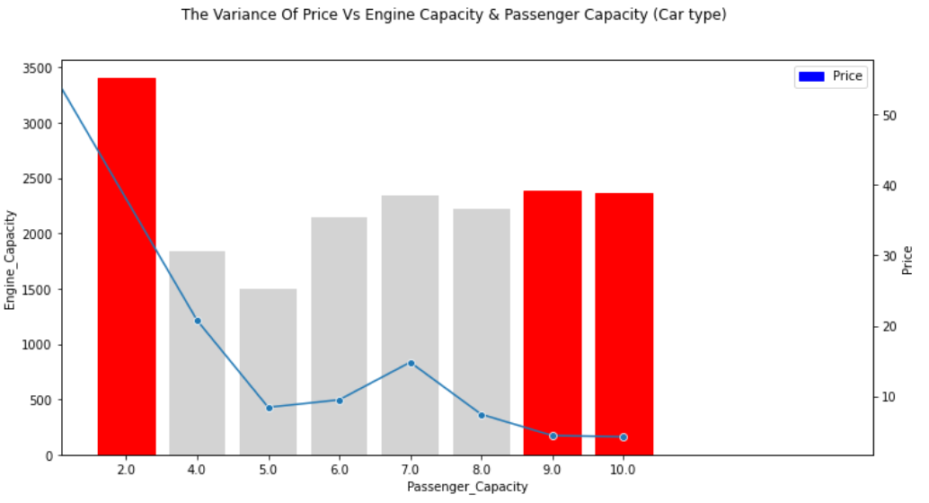
Engine Capacity
In general, used car prices tie closely with the Engine capacity, except for SUV, MUV and super sports car type.
Except for the super sports car, high seated capacity car need higher Engine capacity to operate.

Slide 19
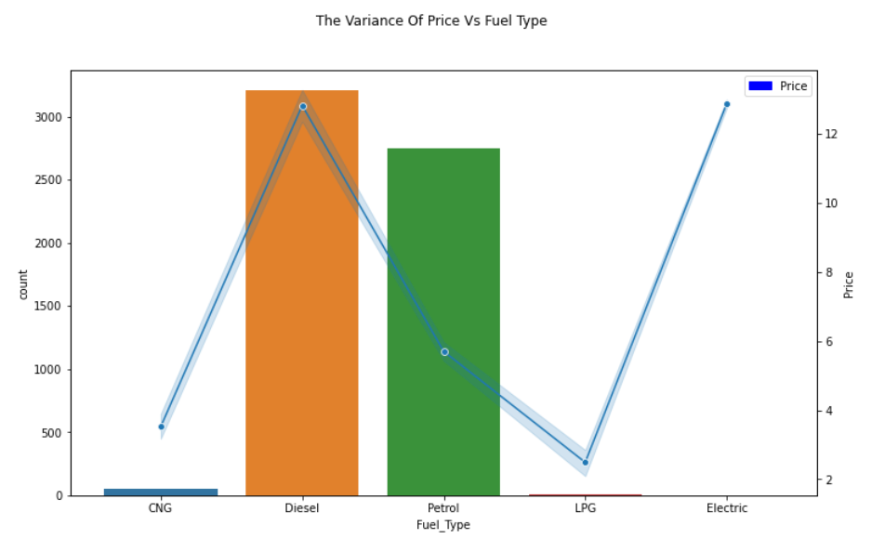
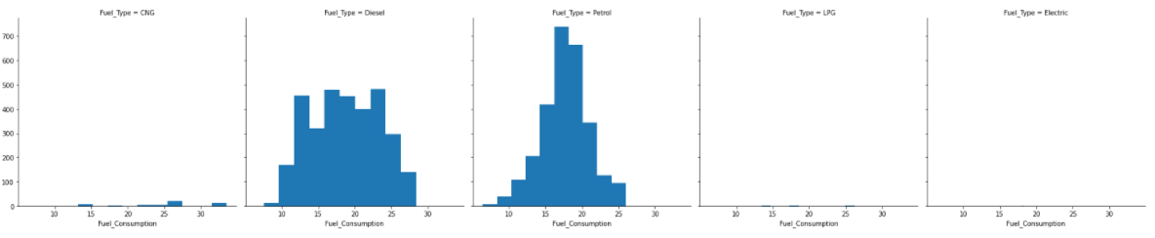
Fuel Type
Diesel cars are the most popular options in India. Even though the car price is higher but due to the savings in the cost of fuel (average of 11% to 13% cheaper compared Petrol and Diesel) and a lower fuel consumption per kilometer driven, car buyers are still more than willing to go for diesel car instead.

Slide 20
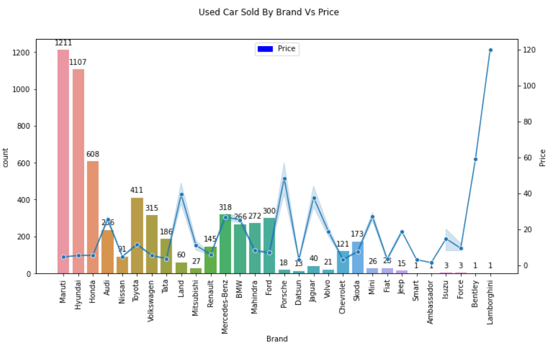
Brand
The top 3 most popular economic category brands in India are Maruti, Hyundai and Honda. For the luxury category, Mercedes-Benz, BMW followed by Audi are still the best preferences for the car buyers. Due to the similarity in price, overseas brands like Volkswagen and Ford sell better compared to local brands such as Mahindra and Tata.

Slide 21
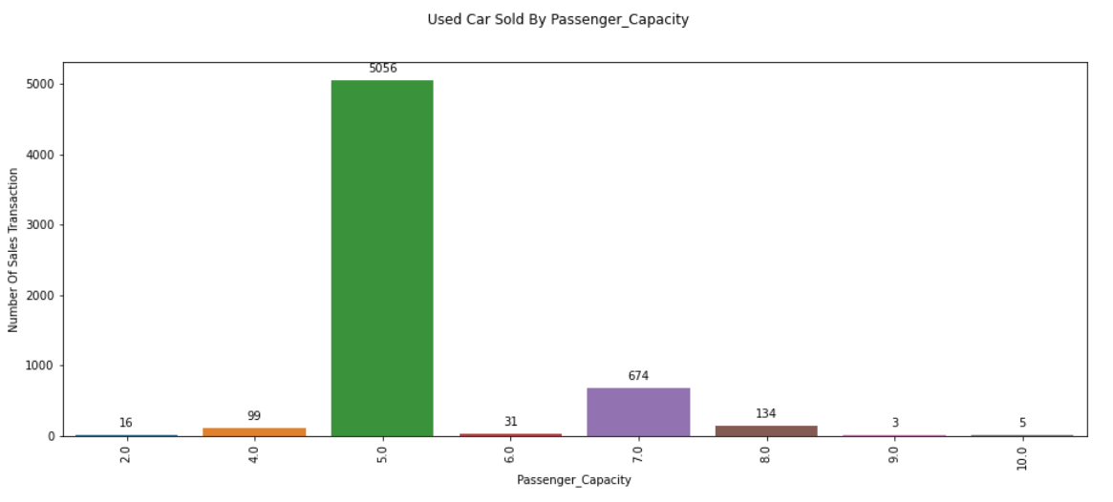
Passenger Capacity
Saloon(5 seated) cars still the most popular options for general use. But for a bigger family or commercial usage, an MPV or 7 seated car is another best choice.

Slide 22
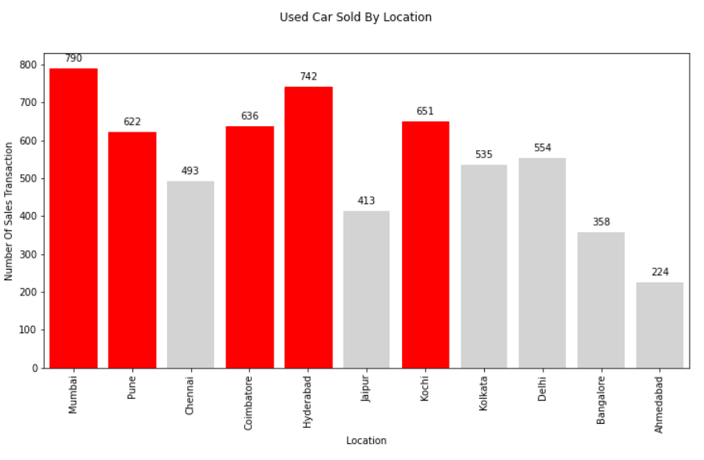
Location
Mumbai has the most transactions, followed by Hyderabad, Kochi, Coimbatore and Pune.

Slide 23
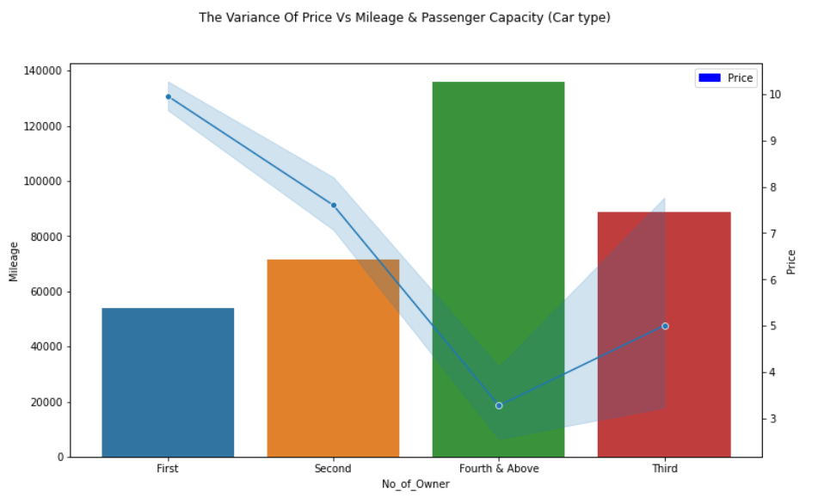
Mileage
Price will be decreased with higher mileage and higher in number of owner.

Slide 24
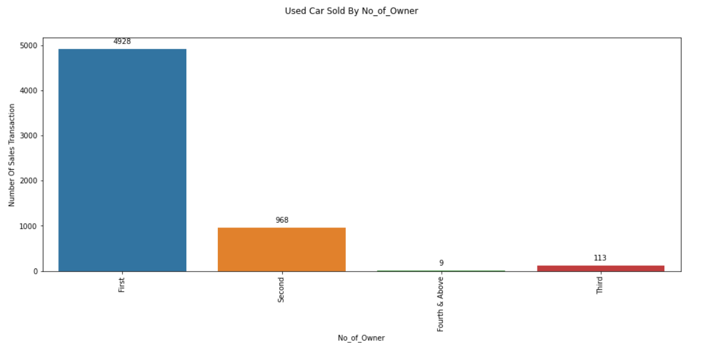
No of Owner
The buyer still prefers to buy a car that has a lesser past owner.

Slide 25

Modeling

Slide 26
Modeling – Flow & process
Based on the dataset provided and the task assigned to do the prediction on used car pricing, multivariate regression algorithms under supervised learning will be best used in this scenario.
As Regression is used for predicting the occurrence of an event depending on the degree of association with variables.
Run a XGBoost Regressor base model with the train set and evaluate it by R-Squared metrics.
Use GridSearCV to find optimal parameters.
Use K-fold cross validator to examine which best classifier algorithms to apply, select the best classifier which generated the best CV score, and run a base model.
Tune the model by the best parameters from GridSearchCV.
Evaluate the Tuned model by the R-Squared metrics.
Identify the feature_importances by the tune model.

Slide 27
Modeling – result
K-Fold cross-validation is a statistical method used to estimate the skill of machine learning models.
It is commonly used in applied machine learning to compare and select a model for a given predictive modeling problem because it is easy to understand, easy to implement, and results in skill estimates that generally have a lower bias than other methods.
K-Fold CV
Linear Regression : 0.845452
Ridge : 0.845459
Random Forest : 0.931792
Gradient Boosting : 0.925284
XGBoosting : 0.943048
XGBoost (Extreme Gradient Boosting) is a powerful decision-tree-based ensemble Machine Learning algorithm that uses a gradient boosting framework. GB builds an additive model in a forward stage-wise fashion; it allows for the optimization of arbitrary differentiable loss functions. In each stage, a regression tree is fit on the negative gradient of the given loss function. The predictive power of these individual models is weak and prone to overfitting but combining many such weak models in an ensemble will lead to an overall much improved result.
Xgboost used a more regularized model formalization to control over-fitting, which gives it better performance. It also has other qualities like computation power, sparse aware split finding to handle etc.

Slide 28
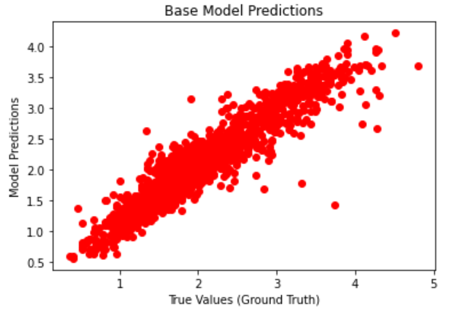
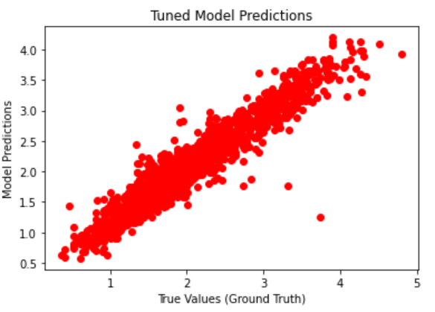
Modeling – result
R-Squared
measures the degree of variability on dependent variables that can be explained by the model.
A metric to determines how well the model fits the dependent variables
Nearer to 1.0 is better, range of 0.8 and above is good
In this case, the predicted R-squared reveals that up to 90.40% of the data fits in the tuned model.
Base Model’s metric
RMSE = 0.258
MAE = 0.185
R2 = 0.879
Tuned Model’s metric
RMSE = 0.231
MAE = 0.166
R2 = 0.904

Slide 29
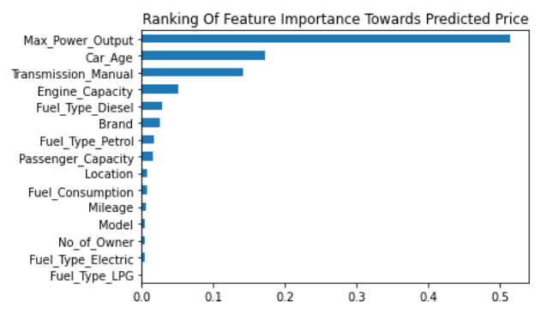
👉Feature importance scores play an important role in a predictive modeling project, including providing insight into the data, insight into the model, and the basis for dimensionality reduction and feature selection that can improve the efficiency and effectiveness of a predictive model on the problem.

Slide 30

Summary

Slide 31
Used car price tie very closely with the Max_Power_Output.
2, 4 and 7 seated cars come with higher horsepower. To generate higher profit thru higher selling price, above mentioned car type should be the focus categories.
Due to the high depreciation from 1st year to 3rd year, used car aged from 4 to 6 years is more popular due to lower depreciation after the 3rd year.
A manual car is more popular in the Indian market. Besides the overall price is cheaper, the fuel consumption of a manual car is more savings compared to an automatic car.
Diesel cars are the most popular options in India. Even though the car price is higher but due to the savings in the cost of fuel (average of 11% to 13% cheaper compared Petrol and Diesel) and a lower fuel consumption per kilometer driven, car buyers are still more than willing to go for diesel car instead.
The top 3 most popular economic category brands in India are Maruti, Hyundai and Honda. For the luxury category, Mercedes-Benz, BMW followed by Audi are still the best preferences for the car buyers. Due to the similarity in price, overseas brands like Volkswagen and Ford sell better compared to local brands such as Mahindra and Tata.
Saloon(5 seated) cars still the most popular options for general use. But for a bigger family or commercial usage, an MPV or 7 seated car is another best choice.
Mumbai has the most transactions, followed by Hyderabad, Kochi, Coimbatore and Pune.
Price will be decreased with higher mileage and higher in number of owner.
The buyer still prefers to buy a car that has a lesser past owner.

Slide 32

Questions
&
Answers

Slide 33
Thank you

